Slide 1
Windows Azure Introducing Virtual Machines (IaaS)
Mario Szpuszta
Platform Strategy Advisor, EMEA Windows Azure Incubation
Microsoft Corporation

Slide 2
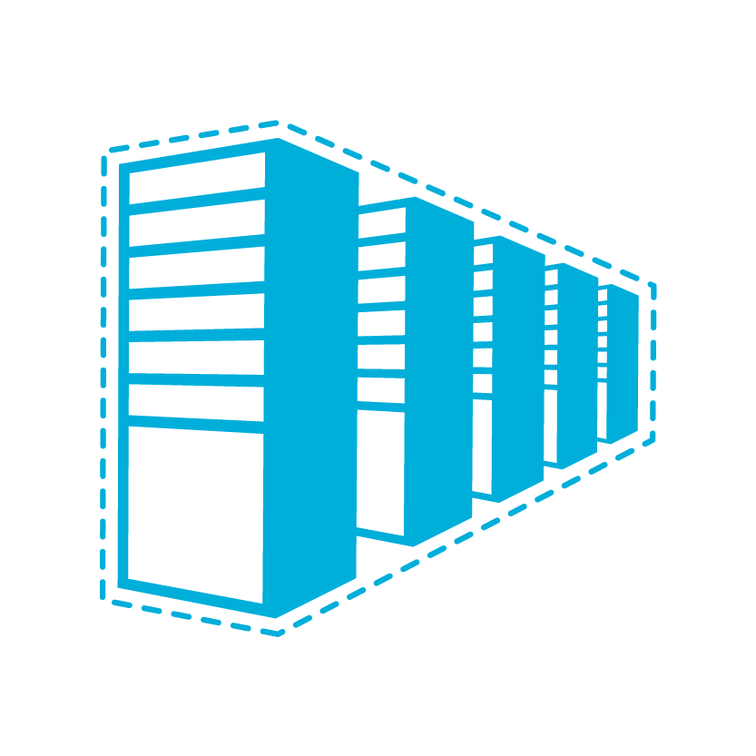
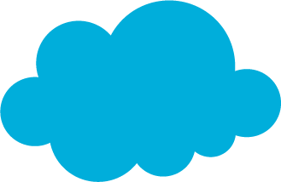
Infrastructure as a Service
The spring release of Windows Azure Infrastructure as a Service introduces new functionality that allows full control and management of virtual machines along with an extensive virtual networking offering.
If deploying an application requires a developer’s involvement, it’s not IaaS
Notes:
Expanding Windows Azure capabilities to provide infrastructure as a service
Provides us with a full continuum of offerings
Brings us relative parity with Amazon, who focuses on IaaS
IaaS Details
Durable virtual machines with Windows Server or Linux
Commercial and community Linux distributions
Select from a library of images or bring your own
E.g. Select an image with SQL Server
Licensing approach
Support SharePoint, SQL Server & Active Directory within IaaS images
Enable deployments containing both PaaS and IaaS services
Create virtual private networks (VPNs) between on-premise servers and Windows Azure
Single Instance SLA (99.9%)
Planned Upgrade Notification Support
Integration between on-premises and public cloud
Easily create a hybrid virtual private network (VPN) between on-premise servers and Windows Azure
Public / Private cloud symmetry
Write apps to common APIs and services that are available within both Windows Azure and on-premise Windows Server

Slide 3
Cloud Models
On Premises
Infrastructure
(as a Service)
Platform
(as a Service)
Software
(as a Service)
You manage
Applications
Applications
Applications
Applications
Data
You manage
Data
Data
Data
Runtime
Runtime
Runtime
Runtime
Managed by Microsoft
You manage
Middleware
Middleware
Middleware
Managed by Microsoft
Middleware
O/S
O/S
O/S
O/S
Managed by Microsoft
Virtualization
Virtualization
Virtualization
Virtualization
Servers
Servers
Servers
Servers
Storage
Storage
Storage
Storage
Networking
Networking
Networking
Networking
Notes:
Slide Objectives:
Explain the differences and relationship between IaaS, PaaS, and SaaS in more detail.
Speaking Points:
Here’s another way to look at the cloud services taxonomy and how this taxonomy maps to the components in an IT infrastructure.
Packaged Software
With packaged software a customer would be responsible for managing the entire stack – ranging from the network connectivity to the applications.
IaaS
With Infrastructure as a Service, the lower levels of the stack are managed by a vendor. Some of these components can be provided by traditional hosters – in fact most of them have moved to having a virtualized offering.
Very few actually provide an OS
The customer is still responsible for managing the OS through the Applications.
For the developer, an obvious benefit with IaaS is that it frees the developer from many concerns when provisioning physical or virtual machines.
This was one of the earliest and primary use cases for Amazon Web Services Elastic Cloud Compute (EC2).
Developers were able to readily provision virtual machines (AMIs) on EC2, develop and test solutions and, often, run the results ‘in production’.
The only requirement was a credit card to pay for the services.
PaaS
With Platform as a Service, everything from the network connectivity through the runtime is provided and managed by the platform vendor.
The Windows Azure best fits in this category today.
In fact because we don’t provide access to the underlying virtualization or operating system today, we’re often referred to as not providing IaaS.
PaaS offerings further reduce the developer burden by additionally supporting the platform runtime and related application services.
With PaaS, the developer can, almost immediately, begin creating the business logic for an application.
Potentially, the increases in productivity are considerable and, because the hardware and operational aspects of the cloud platform are also managed by the cloud platform provider, applications can quickly be taken from an idea to reality very quickly.
SaaS
Finally, with SaaS, a vendor provides the application and abstracts you from all of the underlying components.

Slide 4
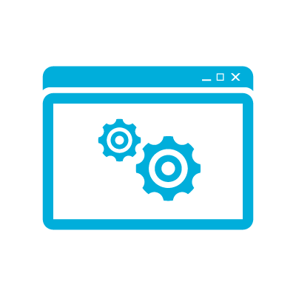

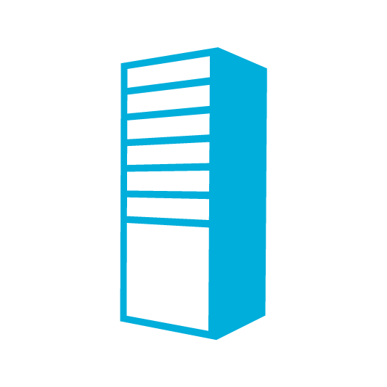
A Continuous Offering From Private to Public Cloud
Physical
Virtual
IaaS
PaaS
SaaS
Notes:
Microsoft provides a continuous solution from private cloud to the public cloud. No matter where you are on your technology roadmap we have a solution to fit your needs.
We are a trusted advisor and platform in the traditional enterprise and ISV space and with the new IaaS offering we are making it easier to bring this same level of trust and ease of use to the public cloud.

Slide 5
Windows Azure Virtual Machines
Support for key server applications and workloads
Easy storage manageability
High availability features
Advanced networking
Integration with compute PaaS
Easy Application Migration
If it requires development, it’s not IaaS
Notes:
Windows Azure Virtual Machines and Virtual Networks support adds the capability to run key server applications and workloads such as Active Directory, SharePoint, SQL Server and most applications that run on a Virtual Machine today.
Adding storage capacity is simple. Either through the portal or PowerShell add up to 16 TBs of storage on an X-Large VM.
Virtual machines allows you to the option of splitting virtual machine loads across multiple racks in the data center using availability sets.
Virtual Networks provide the capability of connecting two cloud services for direct communication. This enables scenarios such as web and worker roles communicating directory with SQL Server.
Application migration is much simpler. In most cases the app will just run without changes on a virtual machine.

Slide 6


Images Available at Preview
Windows Server 2008 R2
Windows Server 2008 R2 with
SQL Server 2012 Evaluation
Windows Server 8 RC
OpenSUSE 12.1
CentOS 6.2
Ubuntu 12.04
SUSE Linux Enterprise Server SP2
Windows
Linux

Slide 7
Virtual Machine vs VM Role
 | VM Role | Virtual Machine
Storage | Non-Persistent Storage | Persistent Storage Easily add additional storage
Deployment | Build VHD offsite and upload to storage. | Build VHD directly in the cloud or build the VHD offsite and upload
Networking | Internal and Input Endpoints configured through service model. | Internal Endpoints are open by default. Access control with firewall on guest OS. Input endpoints controlled through portal, service model or API/Script.
Primary Use | Deploying applications with long or complex installation requirements into stateless PaaS applications | Applications that require persistent storage to easily run in Windows Azure.

Slide 8
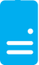
Persistent Disks and Highly Durable
Windows Azure Storage (Disaster Recovery)
Windows Azure Storage
Virtual Machine
Notes:
The OS and Data Disks are stored in Windows Azure storage. So in addition to the data being persistent you also get the benefits of storage which means your VHD is replicated 3X’s locally and also 3X’s in a separate data center in the same region (geo-replication)

Slide 9
Persistent Disks and Highly Durable
Windows Azure Storage (Disaster Recovery)
Windows Azure Storage
Virtual Machine
Virtual Machine
Notes:
This slide simply highlights that if the physical hardware backing your VM goes down a new server will start and pick up the same VHD.

Slide 10
Disks and Images
OS Images
Microsoft
Partner
User
Base OS image for new Virtual Machines
Sys-Prepped/Generalized/Read Only
Created by uploading or by capture
Disks
OS Disks
Data Disks
Writable Disks for Virtual Machines
Created during VM creation or during upload of existing VHDs.

Slide 11



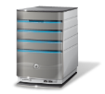



Cross-premise Connectivity
CLOUD
ENTERPRISE
Data Synchronization
SQL Azure Data Sync
Application-layer
Connectivity & Messaging
Service Bus
Secure Machine-to-Machine Network Connectivity Windows Azure Connect
Secure Site-to-Site
Network Connectivity
Windows Azure Virtual Network
IP-level connectivity
Notes:
Microsoft think about the stack to provide connectivity between on-premise and cloud.
Specifically this deck focuses on the last two layers
Servicebus vs connect – SB requires app code change, Connect/Virtual Networks do not.
Virtual Networks are the net new here. They provide site to site connectivity where Connect provided server to server connectivity.
Virtual Networks are the more flexible and powerful option.

Slide 12
Windows Azure Virtual Network
Your “virtual” branch office / datacenter in the cloud
Enables customers to extend their Enterprise Networks into Windows Azure
Networking on-ramp for migrating existing apps and services to Windows Azure
Enables “hybrid” apps that span cloud and their premises
A protected private virtual network in the cloud
Enables customers to setup secure private IPv4 networks fully contained within Windows Azure
IP address persistence
Inter-service DIP-to-DIP communication
Corpnet
Windows Azure
VM 1
VM 2
Subnet 1
Subnet 2
ROLE 1
Notes:
Windows Azure Virtual Networks is our solution to providing hybrid solutions and solutions that require advanced connectivity in the cloud.
Hybrid on-premises to cloud is enabled by using the VPN solution that allows site<->site connectivity allowing machines on premise and machines in the cloud to appear on the same network.
Advanced connectivity solutions are enabled because Windows Azure applications that are deployed in to a virtual network will have persistent IP addresses. This is a requirement for solutions like Active Directory.
Other solutions enabled by virtual networks in the cloud are mixing VMs and web/worker role solutions in the same Windows Azure network. This allows for scenarios like web/worker roles to communicate back to VMs running applications like SQL server.

Slide 13
Windows Azure Virtual Network Scenarios
Hybrid Public/Private Cloud
Enterprise app in Windows Azure requiring connectivity to on-premise resources
Enterprise Identity and Access Control
Manage identity and access control with on-premise resources (on-premises Active Directory)
Monitoring and Management
Remote monitoring and trouble-shooting of resources running in Windows Azure
Advanced Connectivity Requirements
Cloud deployments requiring persistent IP addresses and direct connectivity across services

Slide 14



Bringing Workloads to the Cloud
On Premises
Production
SQL Farm
IIS Servers
SharePoint
PaaS Roles
S2S VPN tunnels
AD / DNS
S2S VPN Device
File Servers
Local AD
SQL VMs
Exchange

Slide 15
IaaS and PaaS – Better Together
Physical
Virtual
IaaS
PaaS
SaaS
Notes:
Building new PaaS applications is a no-brainer when looking at some of the benefits:
Simplified Deployment and Configuration
Health Model
Easy High Availability
Instance Scalability
OS Patching
Automatic Firewall Configuration
Simple Certificate Deployment
However, building new applications sometimes comes with a dependency on other systems or legacy code.
This has sometimes blocked the development of PaaS applications. The IaaS offering will unblock these types of applications and allow for the two development models to co-exist and directly communicate.

Slide 16
Why Mix Models?
What Value does this Provide?
Unblocks Development or Migration of new applications that have dependencies on resources that require virtual machines such as Active Directory, MongoDB, MySQL, SharePoint, SQL Server, COM+, MSMQ etc…
Migration On-Ramp for Existing Applications
Administrators can quickly take advantage of Windows Azure by migrating an existing application as-is using virtual machines. If desired, connecting different application models such as websites or web and worker roles provides the capability to take advantage of PaaS roles alongside IaaS roles.

Slide 17
Windows Azure Service Model Example cloud service configuration with a single web role and a single worker role
Cloud Service
Web Role
Worker Role
VM₁
VM₂
VM₃
VM₄
VM₁
VM₂
VM₃
VM₄
VM₅
VM₆
VM₇
VM₈
VM₅
VM_{n}
…
VM₉
VM_{n}
…

Slide 18
Mixing Virtual Machines and Stateless Roles Multiple cloud services with stateless and virtual machines
Cloud Service 1
Cloud Service 2
Web Role
Worker Role
Virtual Machine
Virtual Machine
VM₁
VM₂
VM₁
VM₂
VM₅
VM₆
VM₅
VM₆
VM₁
VM₁
VM_{n}
VM_{n}
…

Slide 19

Connecting Cloud Services via VIPs
Strengths
Simplicity
Tenant Autonomy
VIP Swap (stateless roles)
Easy Local Dev/Test
Persistent Service is Easily Accessible (even from other services!)
Cloud
Service 1
SQL Data Access Traffic Through Public Endpoint
Load Balancer
80
WA Web Role
Secure Endpoints with Windows Server Firewall
Weaknesses
Higher Latency Less Secure
Management/Deployment Overhead
Cloud
Service 2
2001-1433
SQL Server
Load Balancer

Slide 20
Deployment Steps (VIP Connectivity)
Deploy VM’s
Deploy Virtual Machine(s)
Customize
Use RDP to customize the new virtual machine(s) by installing software, configuring roles etc.
Configure Endpoints
Configure public endpoints to virtual machine services. ACL with firewall as appropriate.
Local Dev/Test
Build and test locally using the emulator. Testing live can be achieved by using public endpoints.
Deploy Service
Specify instance count and other configuration details. Deploy to a separate hosted service.

Slide 21
Connecting Cloud Services with VNET
Strengths
More Secure
Low Latency
Cloud App Autonomy
VIP Swap (stateless roles)
Advanced Connectivity Requirements
ContosoVNet (10.0.0.0/8)
Cloud
Service1
80
FrontEndSubnet
(10.0.0.0/16)
Load Balancer
WA Web Role
Weaknesses
VNET Complexity
No iDNS – use BYOD
Direct Access via VNET
Cloud
Service 2
SQLSubnet
(10.1.0.0/16)
AD
AD Subnet
(10.2.0.0/16)
SQL Mirror

Slide 22
VNET Connected – Local Testing
ContosoVNet (10.0.0.0/8) → MyAffinityGroup
Cloud
Service1
80
FrontEndSubnet
(10.0.0.0/16)
Manage Multiple Connection
Strings via Multiple Configurations
Load Balancer
WA Web Role
Direct Access via VNET
Developer Fabric
Cloud
Service 2
SQLSubnet
(10.1.0.0/16)
AD Subnet
(10.2.0.0/16)
1433
AD
WA Developer Fabric
SQL Mirror
Developer

Slide 23
VNET Connected with VPN ContosoVNet (10.0.0.0/8) → MyAffinityGroup
On Premises
Cloud
Service 1
80
FrontEndSubnet
(10.0.0.0/16)
WA Developer Fabric
Developer
Load Balancer
WA Web Role
VPN Tunnel
Direct Access via VNET
Cloud
Service 2
AD / DNS
SQLSubnet
(10.1.0.0/16)
Access on premises resources
Local Testing - allows direct connection to Virtual Machines in the cloud
AD
SQL Mirror
Notes:
Slide should

Slide 24
VNET Connected Deployment Steps
Design VNET
Define virtual networks and subnets for hosted services to reside in.
Deploy VM’s
Deploy Virtual Machine(s). If AD is desired deploy at this stage so remaining VMs can start domain joined.
Customize
Use RDP to customize the new persistent VM(s) by installing software, configuring roles etc…
Local Dev/Test
Build and test locally using the emulator. Testing live can be achieved by using public endpoints or VPN connectivity.
Deploy Service
Specify instance count, virtual network settings and other configuration details. Deploy to a separate hosted service.
Make Production Ready
If previously opened, close public endpoints to lock down service.

Slide 25
Mixed Mode – Shared Cloud Service
Strengths
Simplicity
Connectivity
iDNS
Weaknesses
Lack of VIP Swap
Cloud
App
Available in Fall Release
Virtual Machine
80
WA Web Role
Load Balancer

Slide 26
VM to VM Performance
Category | Latency (Round-Trip) | Comment | Network Link Details
Inter-VM within a deployment (or deployment to deployment with VNET) | 0.29 ms | DIP to DIP | Traffic does not flow through the LB
Inter-VM crossing a deployment (same region) | 0.88 ms | VIP to VIP | Traffic flows through the LB

Slide 27
Tiered Migrations
Take Advantage of PaaS Where You Can
Many Applications could benefit from migrating to a mixed deployment. Migrating to web/worker roles or taking advantage of other Windows Azure services (storage, cache etc..)
Benefits of Web and Worker Roles
Simplified Deployment and Configuration
Health Model
Easy High Availability
Instance Scalability
OS Patching
Automatic Firewall Configuration
Simple Certificate Deployment
Many others

Slide 28

Horizontal Migration
Use Virtual Machines and VNET for Forklift Migration
Convert Web Apps to Web Roles (optional)
Convert App Logic to Worker Roles (optional)
Web Tier
AD
Web Role
App Tier
Worker Roles
Convert Data Tier to Azure SQL DB (optional)
Data Tier
SQL Azure

Slide 29
Wrap Up
Connecting IaaS and PaaS
Connecting an application hosted in Windows Azure such as Web Sites or Web/Worker Roles with a Virtual Machine.
Unblocks Building Applications with Dependencies
Dependencies such as Active Directory, SharePoint, SQL Server, Linux, Mongo DB, COM+, MSMQ etc…
Migration On-Ramp for Existing Applications
Migrate application from on-premises take advantage of PaaS efficiencies without blockers on dependencies.

